Slide 1
2021 Pre-Hackathon
December 2021

Slide 2
Task Reminder App
Twilio Tech Titans
Saleem ,Afreen ,Judith,Mushfika ,Ricardo
December 2 ,2021

Slide 3
Content
1. | Introduction
2. | Wireframe
3. | Technologies
4. | Potential Problem Statement
5. | User Stories
6. | Stretch Goals

Slide 4
“A Challenge is not an obstacle,but rather a reminder of a task to be completed ,or a dream to be achieved.”
-Chaker Khazaal

Slide 5

Introduction
Building an app to remind you to do tasks.
A task reminder app that sends text notifications with Twilio to keep users on task with project timelines.Integrate Twilio into a planner to send text and email reminders for upcoming tasks.
Submitting Timesheet
Workout Reminders
Meeting Reminders
Life is full of tasks.

Slide 6
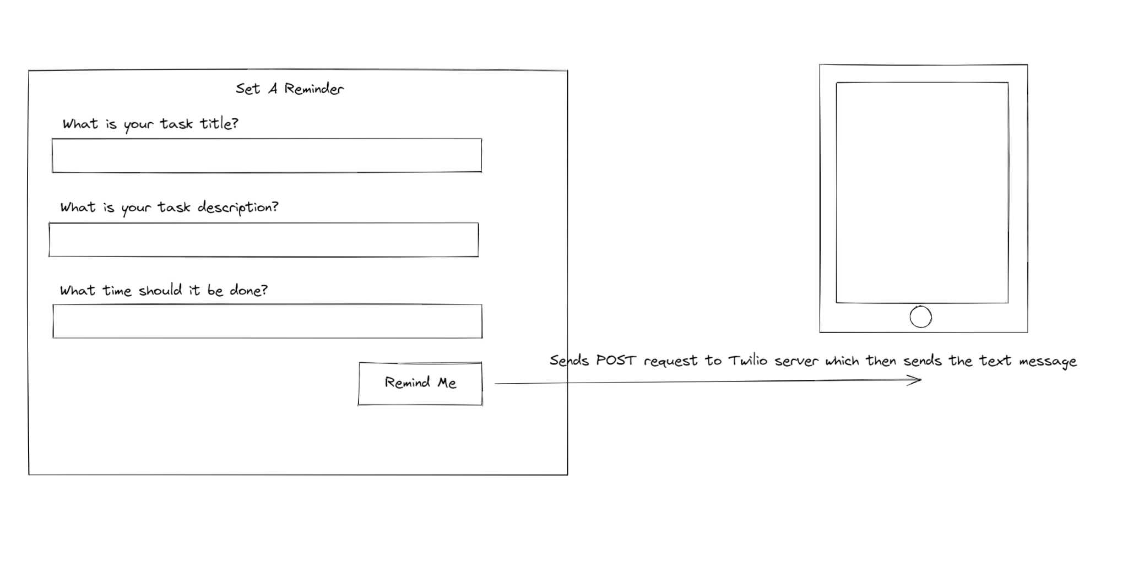
Wireframe

Slide 7



Technologies
Front End -React
No ubique graecis ponderum sea, vis quando altera lobortis at.
Twilio App
No ubique graecis ponderum sea, vis quando altera lobortis at.
Back End-Spring Boot Java
No ubique graecis ponderum sea, vis quando altera lobortis at.

Slide 8
Problem Statement
As a user working on a project, I would like to know when to start my next task so I can hit project milestones.

Slide 9
User Stories
1
2
3
As a user, I want to be able to create a task reminder with a title, description, and time.
As a user, I want to receive a text notification about my task at the correct time.
As a user ,I want to be delete the task when completed.

Slide 10
Stretch Goals
As a user, I want to be able to text back “COMPLETE” to remove the task reminder text.
As a user, I want to be able to have prioritized tasks.
Have reminder pop up during presentation.
As a user ,I want to be able snooze the task.
As a user ,I want to be able to view historical views of completed tasks.

